Slide 1
HM Capital Management
Strategists
Robert Hatem, 12208493
Benjamin Morgan, 12211971

Slide 2
What is Sentiment Data?
Sentimental data refers to textual analysis or natural language processing to identify the states of subjective information. Identifying the polarity of the information is a beneficial task consisting of identifying positive, negative, or neutral sentiment.
Examples of Positive Sentiment:
Chicago pizza is the best pizza.
I really liked the movie.
You are such a nice friend.
Examples of Negative Sentiment:
That popcorn was the absolute worst.
That movie ending was not great.
That was rude of you.
Disclaimer: Past performance does not guarantee future performance. Property of HM Capital Management.

Slide 3
How Does Our Strategy Utilize This
This strategy’s primary objective is to identify positive performing equities with opportunistic future value through a blend of data sources, including sentimental features. These are then used as the inputs into a proprietary model of models to predict next period performance.
Disclaimer: Past performance does not guarantee future performance. Property of HM Capital Management.

Slide 4
The Features
The data our strategy accepts is a mix between sentimental data, found in online articles and news sources, intraday highs and lows, and absolute number of articles online and fundamental financial ratios compiled from a single, historically consistent source.
Disclaimer: Past performance does not guarantee future performance. Property of HM Capital Management.

Slide 5
Investment Universe
Our investment universe consists of equities meeting certain criteria with enough information to appropriately backtest our strategy. The filtering and cleaning of the equity data produces a universe of 1130 equities that meet our precise criteria
Disclaimer: Past performance does not guarantee future performance. Property of HM Capital Management.

Slide 6
What’s Our Competitive Advantage?
Our strategy leverages not 1, but 3 different machine learning models while utilizing a proprietary set of sentiment features
Disclaimer: Past performance does not guarantee future performance. Property of HM Capital Management.

Slide 7
Long-Only Equity Strategy
Monthly long equity positions, with market neutral using market beta
Equities ranked using prediction of performance from prior month
Prediction comes from average of an LSTM, gradient boosting, and logistic regression models
Uses sentiment and fundamental predictors
Rigorous backtesting and model checking
Developed with focus on risk management and capital preservation
Disclaimer: Past performance does not guarantee future performance. Property of HM Capital Management.

Slide 8
Risk Management
The strategy attempted to be market neutral by taking an opposite position of each equity positions by beta times the equity long amount.
However, betas from the previous month occasionally were unreasonably large, resulting in large, often short, market positions. While usually having little effect, these large positions caused large losses if the market moved adversely in that period.
To avoid these large, risky positions, we capped the beta values to a certain range. This lowered the extreme positions from extreme betas.
This beta capping lowered volatility, and softened the large drops found in our initial backtesting.
Disclaimer: Past performance does not guarantee future performance. Property of HM Capital Management.

Slide 9
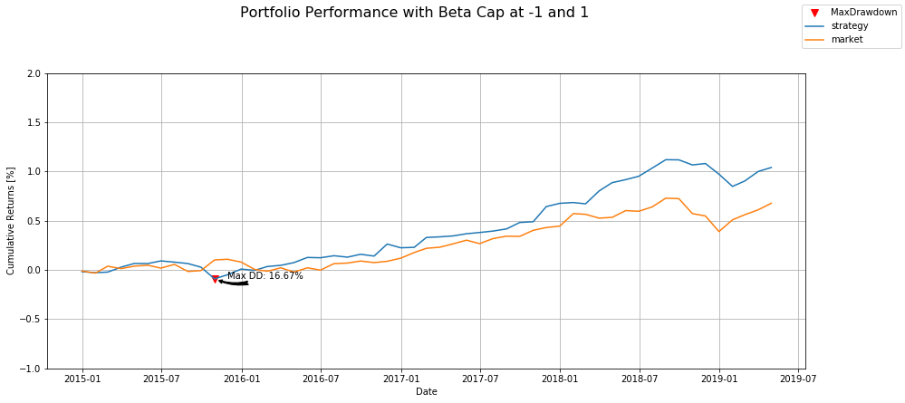
Portfolio Performance vs. Market Performance
Strategy Performance
Total Returns: 104.05%
Annualized Returns: 18.8%
Market Performance
Total Returns: 67.71%
Annualized Returns: 12.9%
Disclaimer: Past performance does not guarantee future performance. Property of HM Capital Management.

Slide 10
Portfolio Performance Metrics since Jan-2015
Annualized Strategy Return | Annualized Market Return | Annualized Strategy Volatility | Annualized Market Volatility | Annualized Sharpe | Max Drawdown | Alpha
18.77% | 12.94% | 13.45% | 14.55% | 1.25 | 16.67% | 0.82%

Slide 11
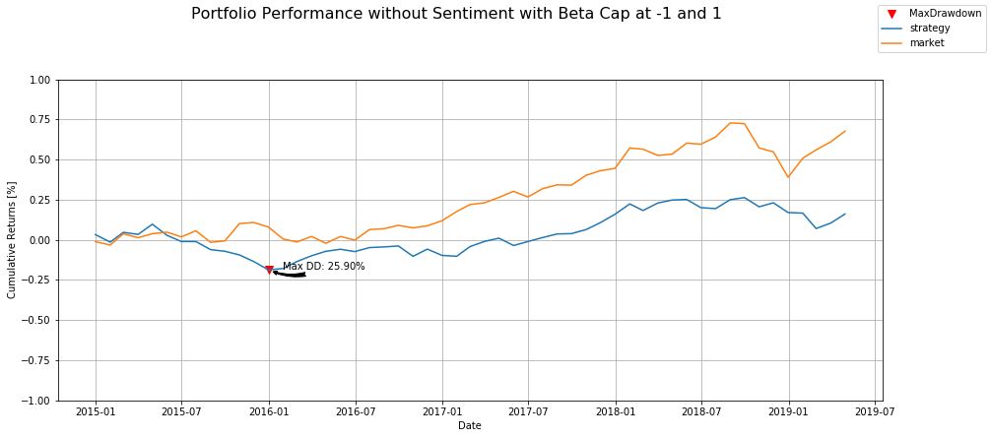
Stress Testing By Comparable Observation
First, we need an idea of how the strategy performs without the sentiment data.
This is a plot of the strategy without sentiment vs the market over the original time period.
Disclaimer: Past performance does not guarantee future performance. Property of HM Capital Management.

Slide 12
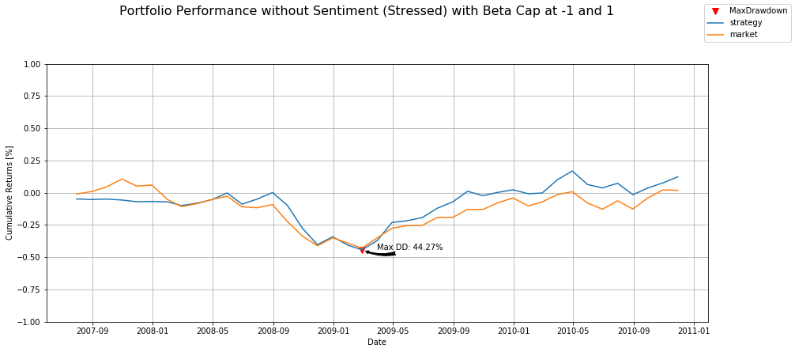
Stress Testing By Comparable Observation
Then we took the same strategy and keeping the split and beta cap the same, ran it against the market over a stressful time period i.e. the 2008 crisis.
Here you can see that the strategy remained fairly robust during this crisis.
Disclaimer: Past performance does not guarantee future performance. Property of HM Capital Management.

Slide 13
In Conclusion...
Following our analysis utilizing sentiment data in our strategy, we believe that there are investment opportunities that we can capitalize on and that this initial analysis provides evidence of proof of concept.
Sentiment data proves to be an unique feature set and as new natural language processing techniques continue to develop and employed, the sentiment data available will continue to grow and offer new ways of exploring different investment opportunities.
Disclaimer: Past performance does not guarantee future performance. Property of HM Capital.

Slide 14
About the Strategist...
Robert Hatem is a graduate student at the University of Chicago working towards a Master’s Degree in Financial Mathematics. He enjoys exploring different machine learning topics and publishing his work on his GitHub page. Robert will be graduating in December 2019.
Benjamin Morgan is also a graduate student at the University of Chicago working towards a Master’s Degree in Financial Mathematics. In his free time, he enjoys photography and being active outside running or playing ultimate frisbee. Benjamin will be graduating in December 2019.

